Slide 1
Data Management
Presented by:-
Ratik Sachdeva
Prajwal Bellignur
Pedro Flores
Huy Nguyen

Slide 2
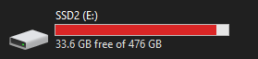
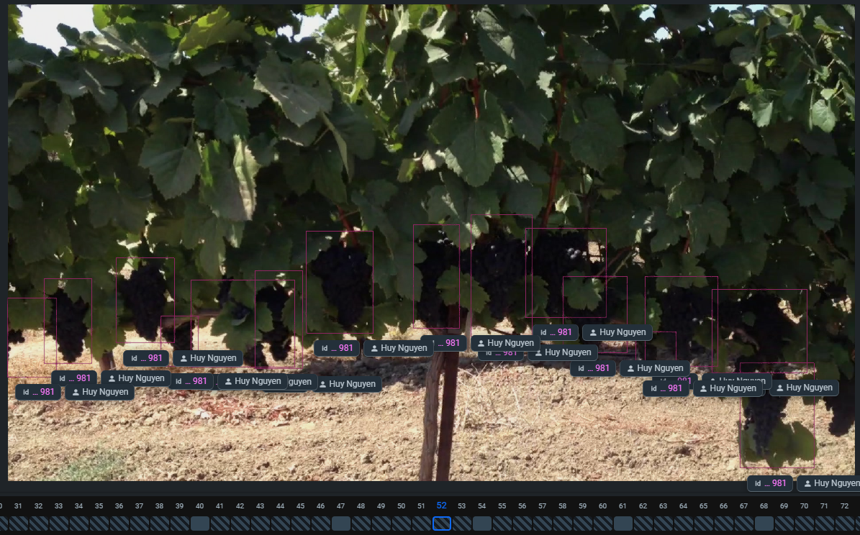
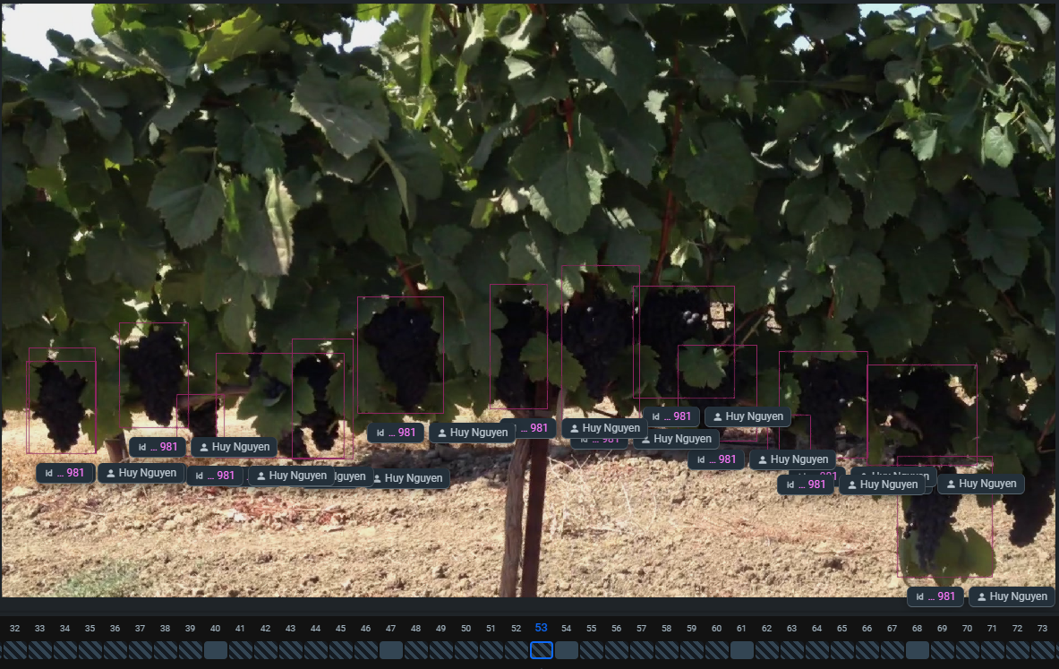
Introduction
Machine learning projects use huge datasets to train models
Large datasets have large storage costs - hundreds of terabytes or more
Lots of data, especially in video datasets, are redundant.
Models train better and more efficiently with less redundant data - data bias!
Difficult to manually pick good data - machine learning automation can solve the problem.
Classified what is good data for the model.
Being able to identified anomalies and remove them.
Very little difference!
Notes:
Most ML projects need huge datasets to train models. Ideally thousands of images or pieces of data should be used for training.
Large datasets have huge storage costs - at UCD, the footage recorded of grapes takes up several terabytes per hour of footage, and they record constantly.
Lots of data is redundant because it’s too similar to other data. In a video, such as the grapevine videos we used in our initial project, 70% of the data or more can be redundant: consecutive frames tend to be very similar, meaning the model does not have the opportunity to detect new relationships, and this will hurt the quality of the model.
It’s difficult to manually separate all of these and determine which images are redundant and which are not. In a 30 second video clip, there are over one thousand frames. In a full dataset, there will be hundreds of thousands of frames or more, and this is impossible to separate by hand.
This is why we developed an automated method to detect and separate redundant data, which will allow researchers to save on space and time, both of which are quite costly.

Slide 3
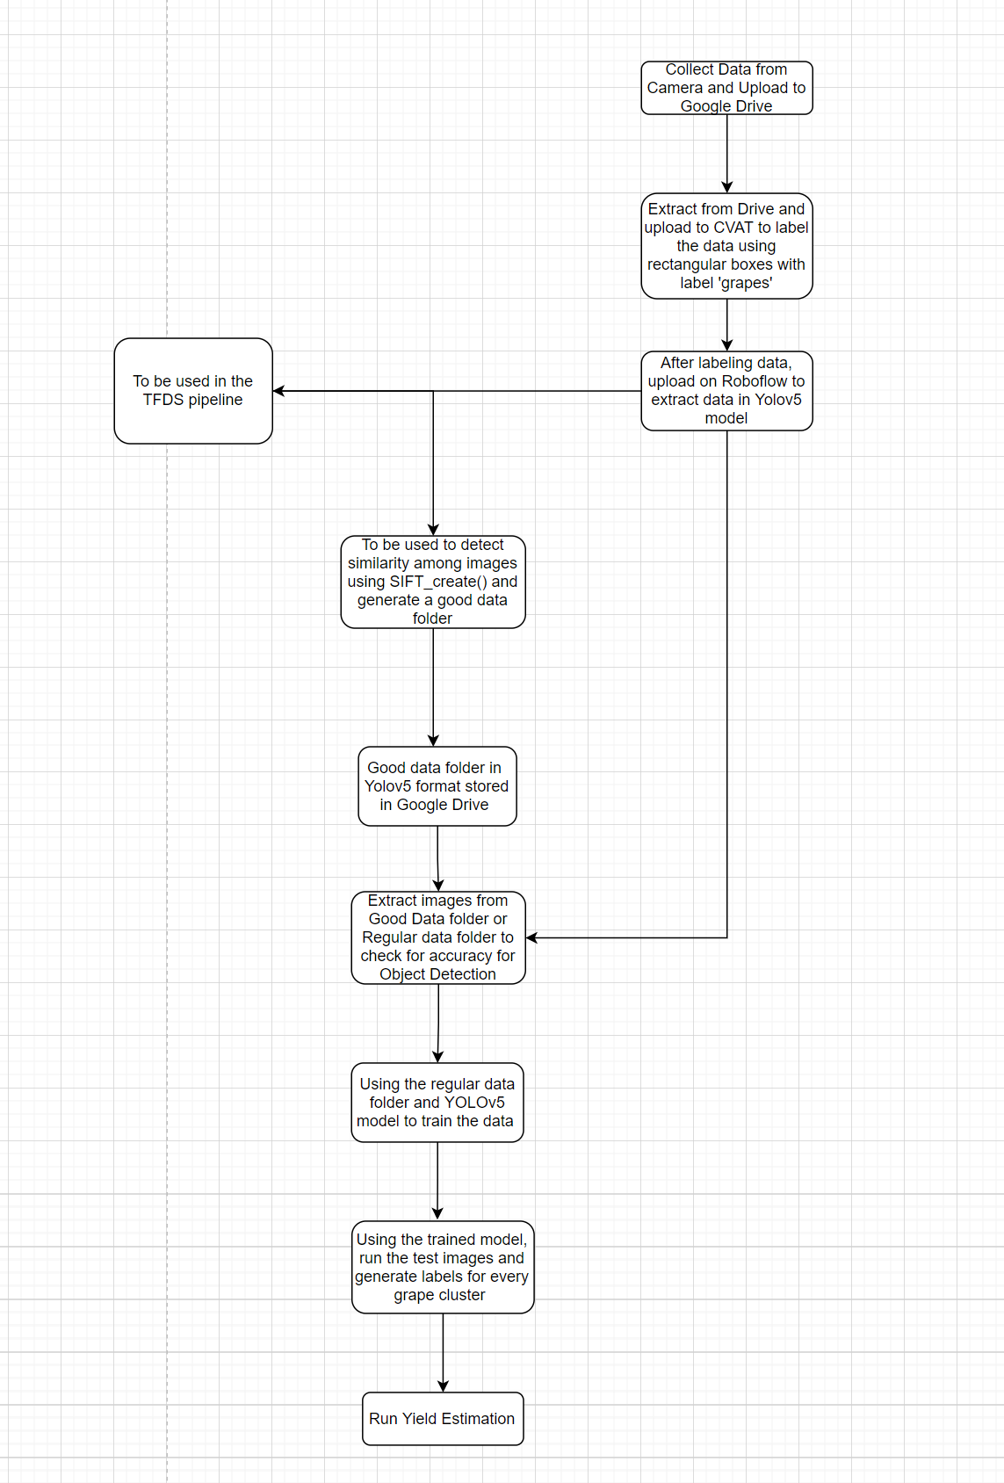
Overall Pipeline

Slide 4
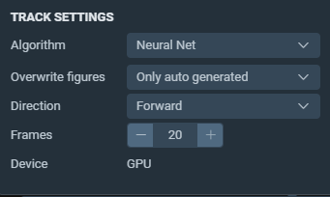
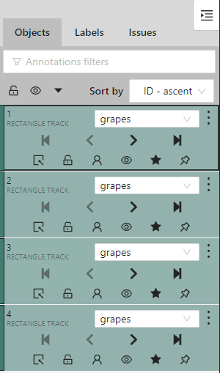
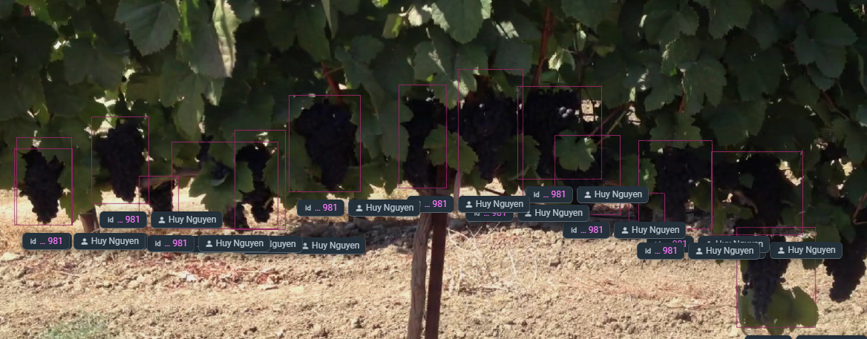
Labeling
Separated videos into separate frames
Used Supervisely for semi-automated labeling, which saves a lot of time
Used Roboflow to augment data and convert annotated images to Yolo V5 format
Annotate using rectangular labels
Mark all visible subjects

Slide 5
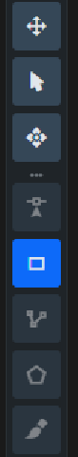
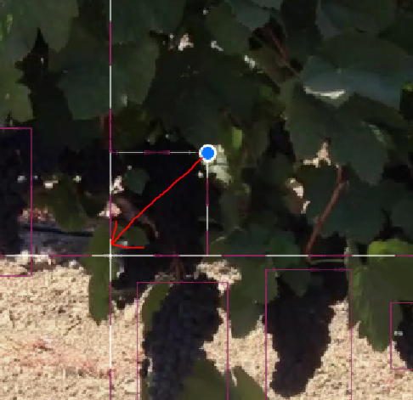
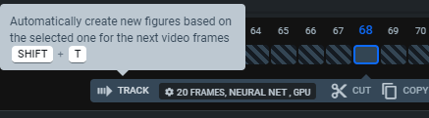
Supervisely
Draw from corner to corner of your subject, keeping as much as possible within the rectangle
Use tracking to auto-generate frames (fewer is better and results in less tracking errors)
Use the rectangular label tool

Slide 6
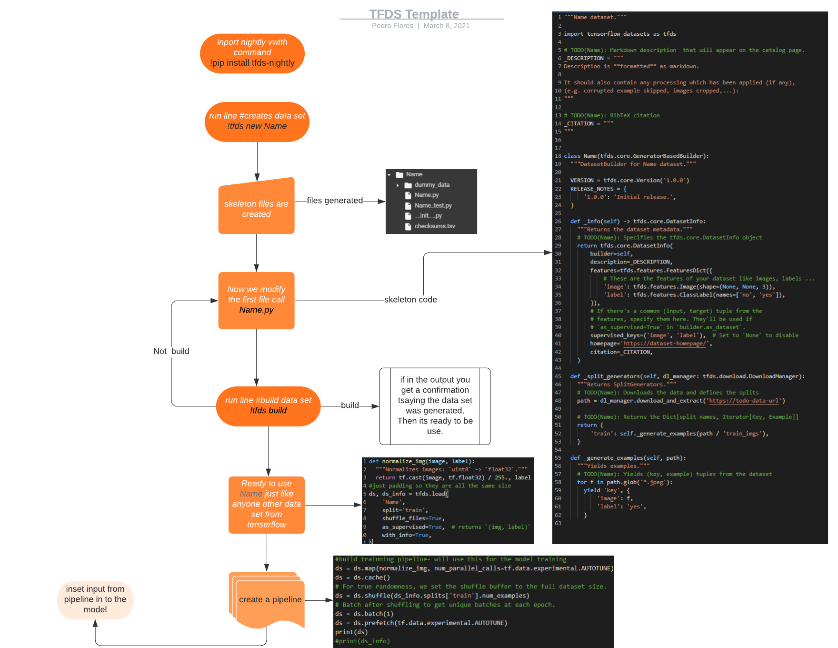

Slide 7
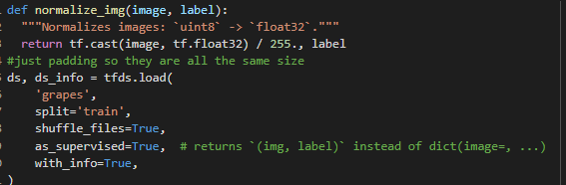
TFDS
TFDS is the standard format for arranging data ready to be use with in tensorflow. It also allows us to create an input pipeline towards the model.
To be able to correctly use the TFDS format we first need to create a database. In other words run a command of tfds to create the skeleton code needed. Then we will need to adapt the skeleton file accordingly to the uniqueness off our raw data. And we should not forget that the data if its images they must all be a consistent size if not then the model with interserflow will not compile. Therefore it is important have a constant size for height and weight.
After creating the dataset now we must generate the dataset by running another tfds command but only after modifying the necessary skeleton files.

Slide 8
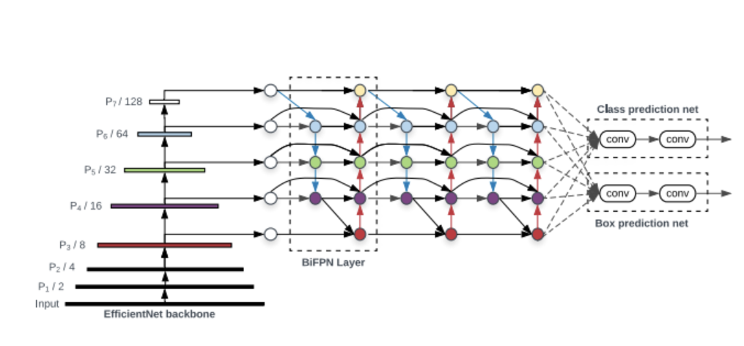
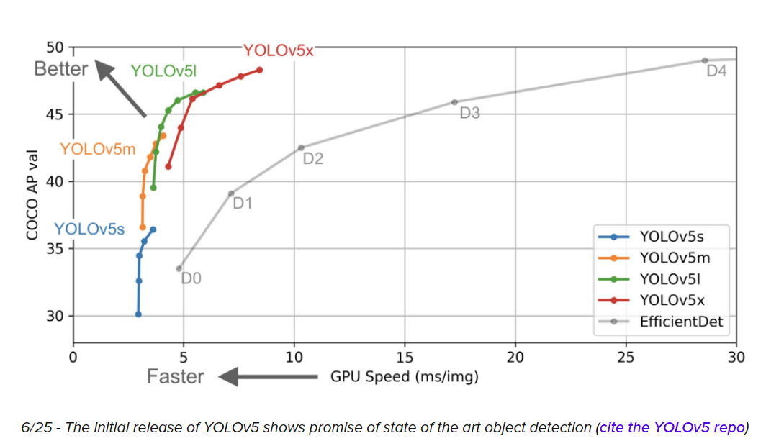
Yolo V5 Model
YOLO(“You Only Look Once”) was initially introduced as the first object detection model that combined bounding box prediction and object classification into a single end to end differentiable network
Written and maintained in a framework called Darknet
YOLO v5 is the first of the YOLO models to be written in the PyTorch framework and it is much more lightweight and easy to use
YOLO algorithms divide all the given input images into the SxS grid system. Each grid is responsible for object detection. Now those Grid cells predict the boundary boxes for the detected object. For every box, we have five main attributes: x and y for coordinates, w and h for width and height of the object, and a confidence score for the probability that the box containing the object.

Slide 9
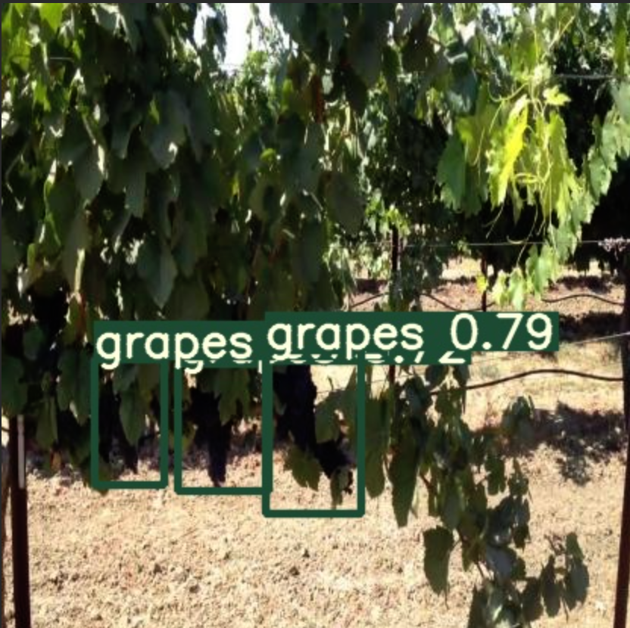
Object Detection
Extract the data from the zip file
Define the YOLO v5 model configuration and architecture
Train the model on the data by inputting different options for the run command
Img, batch, epochs, data, cfg, weights, name, nosave, cache
Visualize the training data on the images which includes data augmentation
Run YOLO v5 inference on the test image set and print the test images

Slide 10
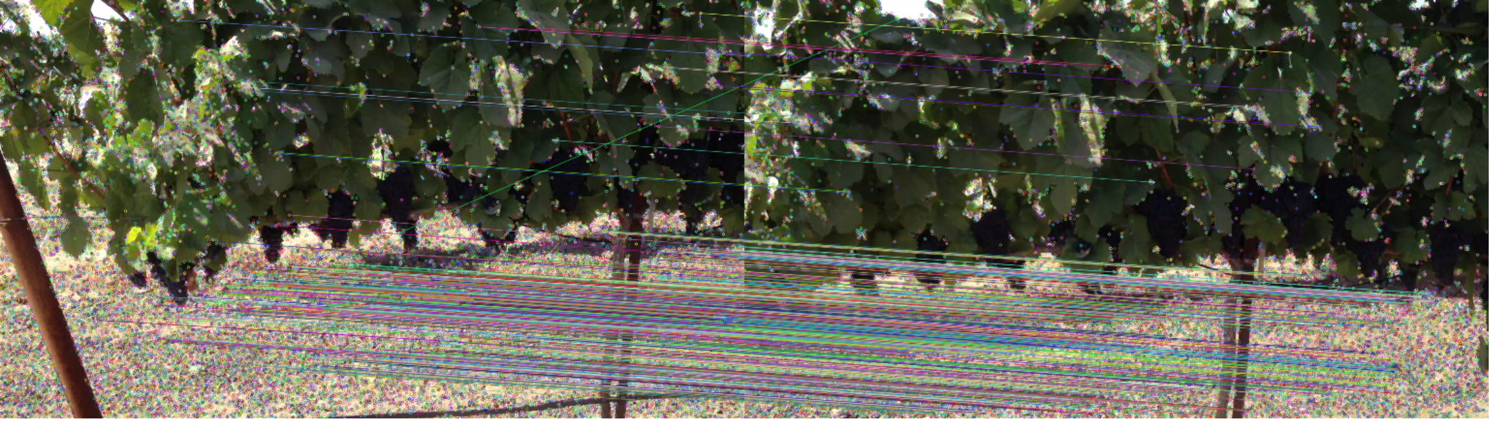
Identifying Redundancy
In this pipeline, we tried to find the similarity between frames, so that we could try to remove some of the images which were similar in order to make sure our model doesn’t get trained on duplicate data.
We wanted to remove these images because repetitive information isn’t useful for the model and it adds more data storage which we don’t need.
For this pipeline, we used SIFT_create() which is a feature from the cv2 module that tries matching points between two images and tries to display how many points are similar in two images.
We tried using our threshold to create two datasets to test the accuracy of our object detection pipeline.
Notes:
Add a slide about similar images -> remove redundant data and what if slide

Slide 11
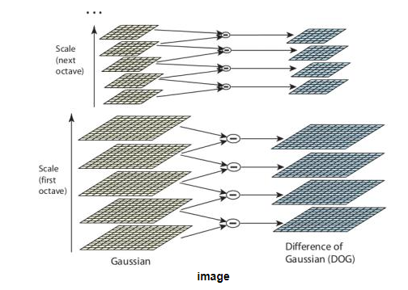
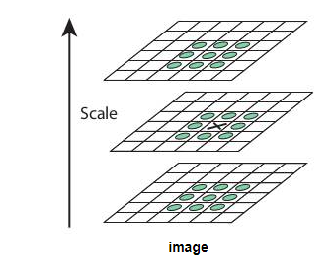
SIFT_create()
SIFT :- Scale-Invariant Feature Transform
There are four steps involved in SIFT:-
Scale-space Extrema Detection
Keypoint Localization
Orientation Assignment
Keypoint Descriptor
SIFT algorithm uses Difference of Gaussians which is an approximation of LoG. Difference of Gaussian is obtained as the difference of Gaussian blurring of an image with two different σ, let it be σ and kσ. This process is done for different octaves of the image in Gaussian Pyramid.
Once this DoG are found, images are searched for local extrema over scale and space. For eg, one pixel in an image is compared with its 8 neighbours as well as 9 pixels in next scale and 9 pixels in previous scales. If it is a local extrema, it is a potential keypoint. It basically means that keypoint is best represented in that scale.
Notes:
2. Keypoint Localization
Once potential keypoints locations are found, they have to be refined to get more accurate results. They used Taylor series expansion of scale space to get more accurate location of extrema, and if the intensity at this extrema is less than a threshold value (0.03 as per the paper), it is rejected. This threshold is called contrastThreshold in OpenCV
DoG has higher response for edges, so edges also need to be removed. For this, a concept similar to Harris corner detector is used. They used a 2x2 Hessian matrix (H) to compute the principal curvature. We know from Harris corner detector that for edges, one eigen value is larger than the other. So here they used a simple function,
If this ratio is greater than a threshold, called edgeThreshold in OpenCV, that keypoint is discarded. It is given as 10 in paper.
So it eliminates any low-contrast keypoints and edge keypoints and what remains is strong interest points.
3. Orientation Assignment
Now an orientation is assigned to each keypoint to achieve invariance to image rotation. A neighbourhood is taken around the keypoint location depending on the scale, and the gradient magnitude and direction is calculated in that region. An orientation histogram with 36 bins covering 360 degrees is created (It is weighted by gradient magnitude and gaussian-weighted circular window with
σ
equal to 1.5 times the scale of keypoint). The highest peak in the histogram is taken and any peak above 80% of it is also considered to calculate the orientation. It creates keypoints with same location and scale, but different directions. It contribute to stability of matching.
4. Keypoint Descriptor
Now keypoint descriptor is created. A 16x16 neighbourhood around the keypoint is taken. It is divided into 16 sub-blocks of 4x4 size. For each sub-block, 8 bin orientation histogram is created. So a total of 128 bin values are available. It is represented as a vector to form keypoint descriptor. In addition to this, several measures are taken to achieve robustness against illumination changes, rotation etc.
5. Keypoint Matching
Keypoints between two images are matched by identifying their nearest neighbours. But in some cases, the second closest-match may be very near to the first. It may happen due to noise or some other reasons. In that case, ratio of closest-distance to second-closest distance is taken. If it is greater than 0.8, they are rejected. It eliminates around 90% of false matches while discards only 5% correct matches, as per the paper.

Slide 12
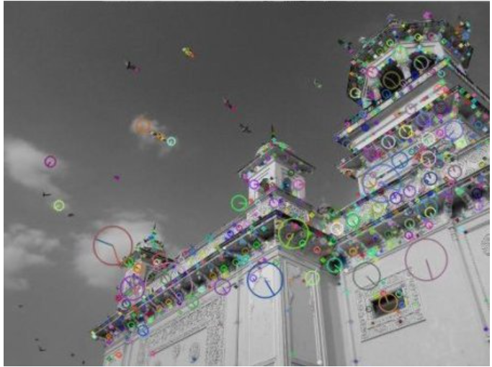
SIFT_create() (Continued)
Keypoint Location
Once potential keypoints locations are found, they have to be refined to get more accurate results. We use Taylor series expansion to get location of extrema,
DoG has higher response for edges, so edges also need to be removed. For this, a concept similar to Harris corner detector is used.
Orientation Assignment
An orientation is assigned to each keypoint to achieve invariance to image rotation
A neighbourhood is taken around the keypoint location depending on the scale, and the gradient magnitude and direction is calculated in that region
Keypoint Descriptor
A 16x16 neighbourhood around the keypoint is taken. It is divided into 16 sub-blocks of 4x4 size. For each sub-block, 8 bin orientation histogram is created. So a total of 128 bin values are available.
Keypoint Matching
Keypoints between two images are matched by identifying their nearest neighbours. But in some cases, the second closest-match may be very near to the first. It may happen due to noise or some other reasons. In that case, ratio of closest-distance to second-closest distance is taken

Slide 13
What if
If we had a couple of more months and had we been provided the data earlier. Then with the videos from the depth-sensing camera. We would have tried to make use of the GPS location and track down the images taken from the same place at different points in time and tried to remove them from the dataset (because they are redundant images) because we wanted to train our object detection model with the best possible data for better accuracy.
Also we were thinking of using the deep-sensing camera to simplifies our calculations and result in a more accurate yield estimation.

Slide 14
Yield Estimation
With the object detection code we are able to obtain the bounding boxes that are acquire from the model. These boxes are not the one’s which we label but what the model identifies for the specific object. By using these boxes we came up with a simple idea, to uptained the best yield estimation with a 3-D prediction from a 2-D images which does not contain distance information.
Idea: fit an inverted cone within the bounding boxes for obtaining the yield estimation. We are to obtain the yield estimation by using the volume equation ⅓ pie r^2 h. Also by knowing the average grape size for the current variety which we are working will be sure as a reference. And will be use to convert between the image parameters in to actual measurements.
Calculations: We extract both the height and the radius by using the generating boxes. The distance with in the y-coordinates will be set equal to the cone’s height. And the distance in the x-coordinates divide by 2 will be set to the radius.
Benefits: by using a cone shape we are able to bring dept with in our prediction.
Problems: some varieties have different shape clusters and as a result the yield estimation will have a higher error margin as we approach the vertex cone. Also we need data providing actual yield per cluster for confirm and evaluating.

Slide 15
Conclusion
By using TFDS we are able to format the data into widely use and recognize format. This allows the users to convert to another format easily and use tools like tensorflow that are compatible with this format.
With the data anomaly pipeline, the accuracy of the model was stabilized around 75% for all the images
Without the removal of the repetitive data, the accuracy of the model was unstable and was between the range of 45% to 85%
With the removal of the redundant data, we would be saving on storage space as well as making sure our model isn’t biased

Slide 16
Works cited
https://www.tensorflow.org/datasets/overview
https://github.com/tensorflow/datasets
https://blog.roboflow.com/how-to-train-yolov5-on-a-custom-dataset/
https://www.researchgate.net/publication/329073077_Tomato_Yield_Estimation_Based_on_Object_Detection
https://towardsdatascience.com/how-to-train-a-custom-object-detection-model-with-yolo-v5-917e9ce13208
https://github.com/edwardanderson/ci2v
https://www.geeksforgeeks.org/extract-images-from-video-in-python/
https://www.programmersought.com/article/85065300266/
https://towardsdatascience.com/autoencoder-neural-network-for-anomaly-detection-with-unlabeled-dataset-af9051a048
https://docs.opencv.org/master/da/df5/tutorial_py_sift_intro.html

